Slide 1

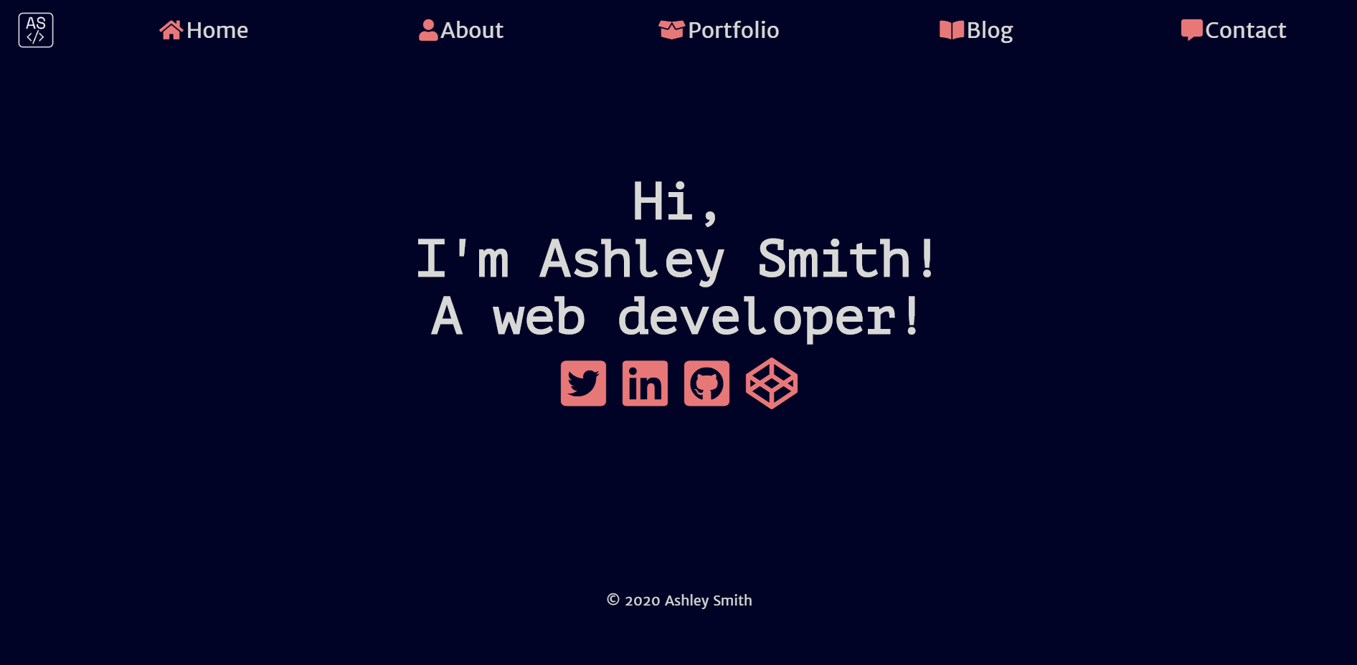
Portfolio Site

Slide 2


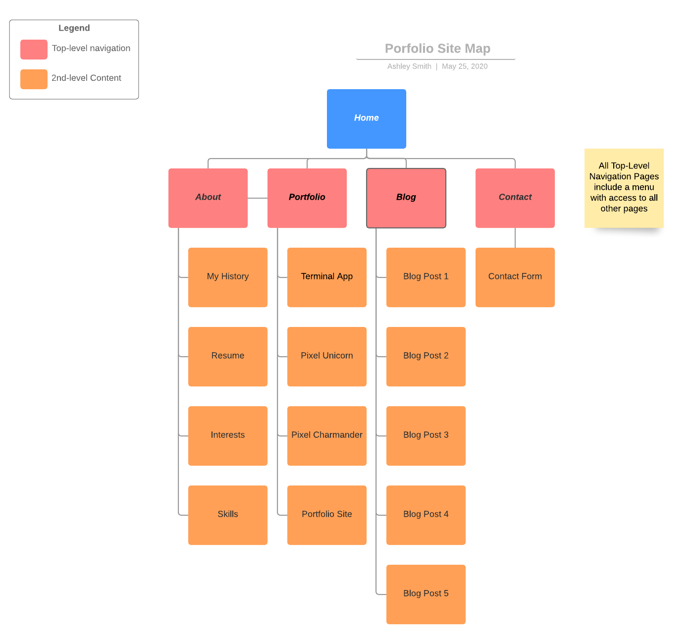
Site Map
The layout of my site pretty straightforward. The user is welcomed to my homepage and from there you’re able to navigate to any page.
On desktop there is a navigation bar in the header and you can navigate to any page from your current location.
On mobile and tablet I’ve employed a hamburger menu which drops down and allows navigation to any page.

Slide 3

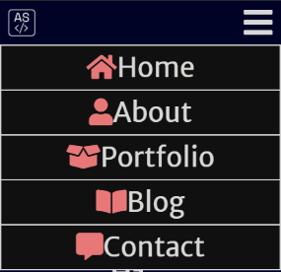
Menus
Desktop
Mobile

Slide 4
Design Process Yes there was one!

Slide 5
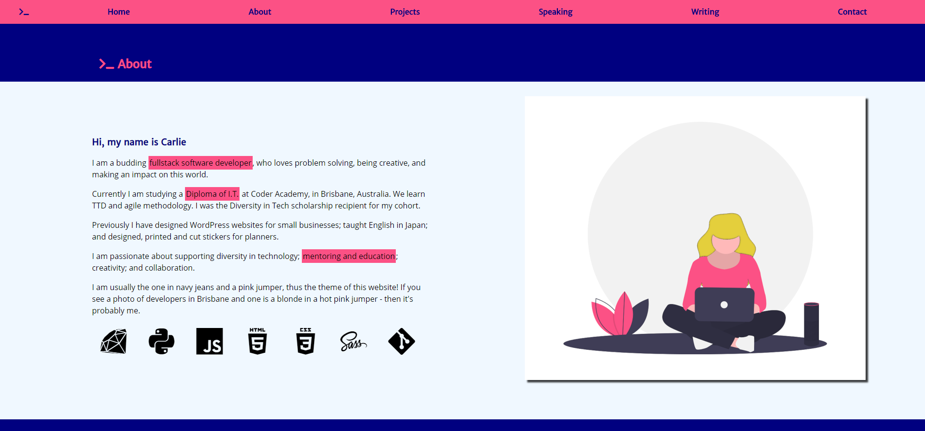
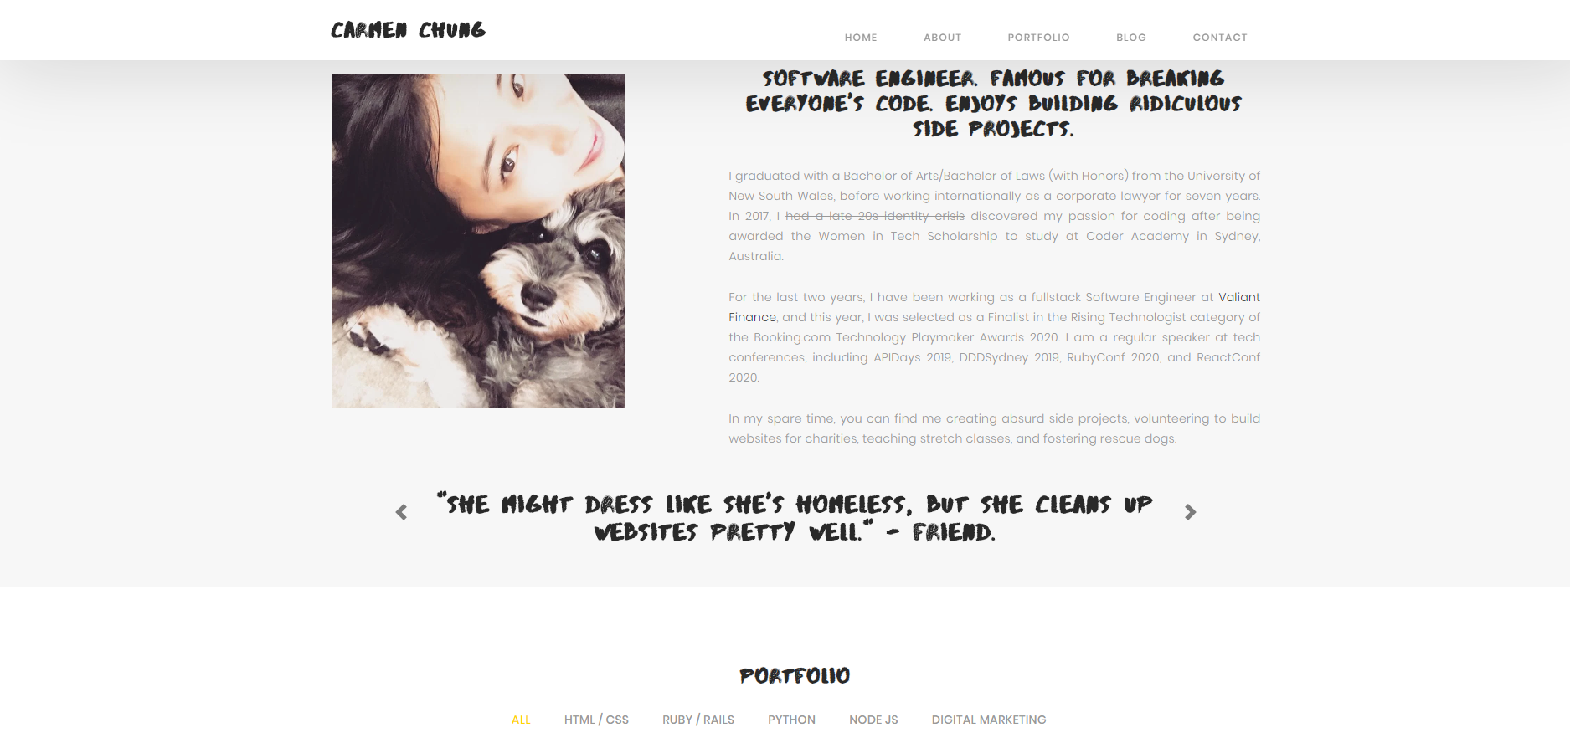
Inspiration

Slide 6
Design Ideas
Clean design
Solid colours
Boxes around text
Pages that tie together and have a clear aesthetic
Animations to make it more interesting
Portfolio highlighting things I’ve made
Navigation made easy
Different text on different screen sizes
Mobile and tablet very similar
My website probably

Slide 7
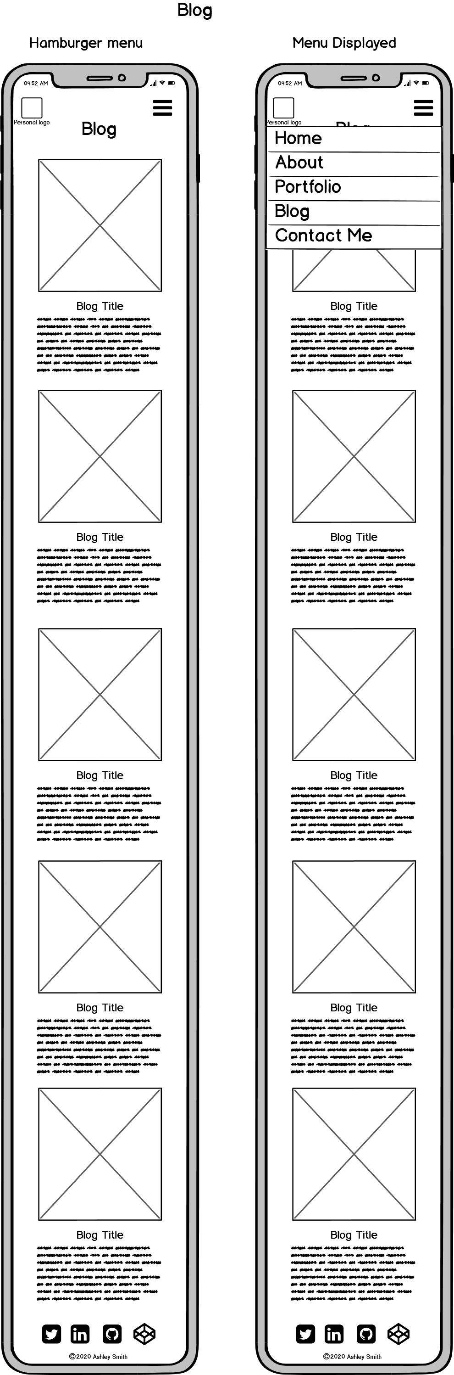
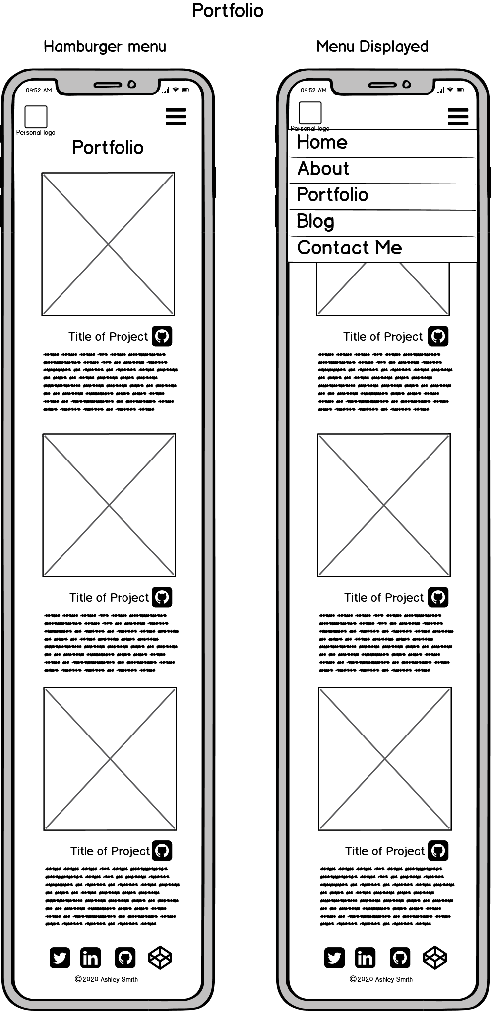
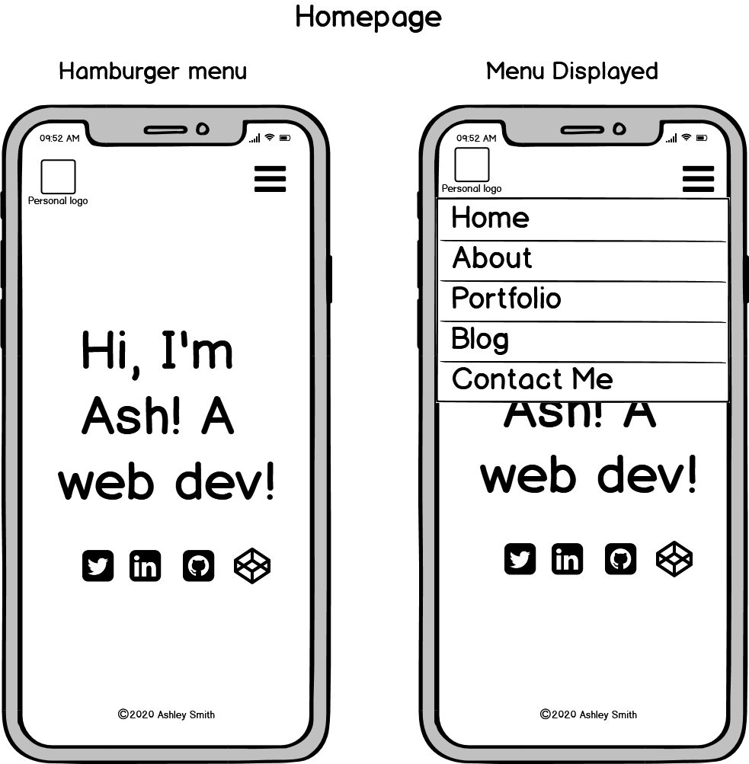
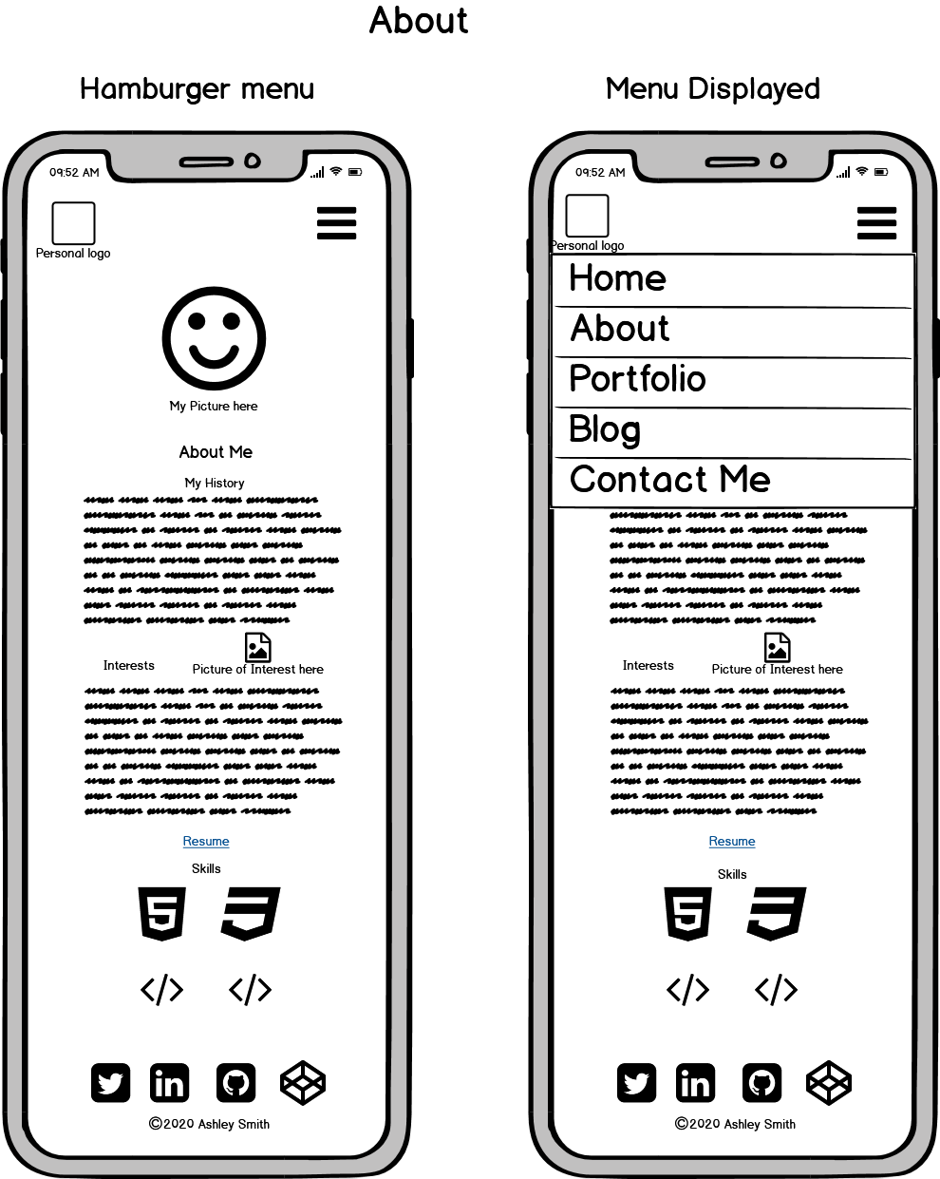
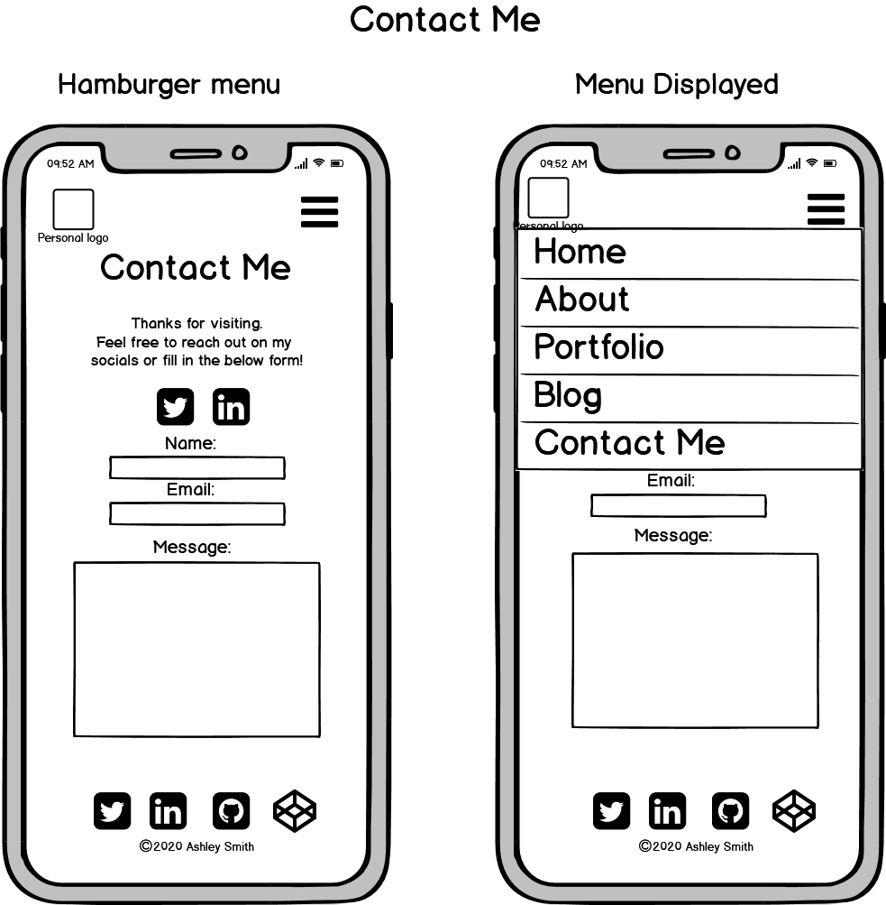
Wireframes - Mobile

Slide 8
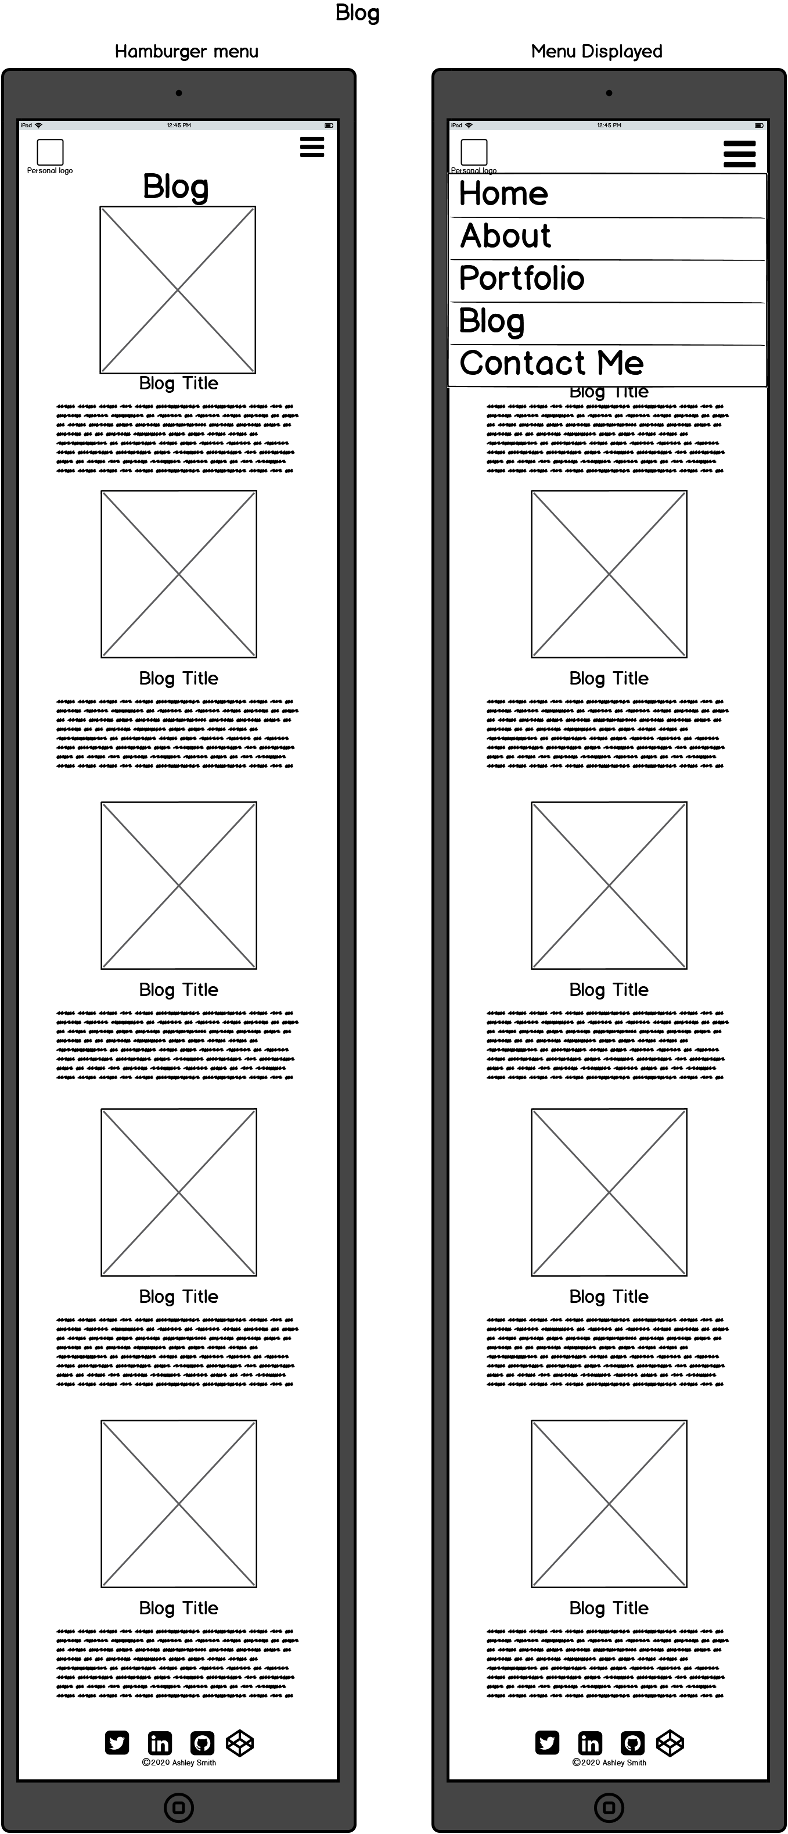
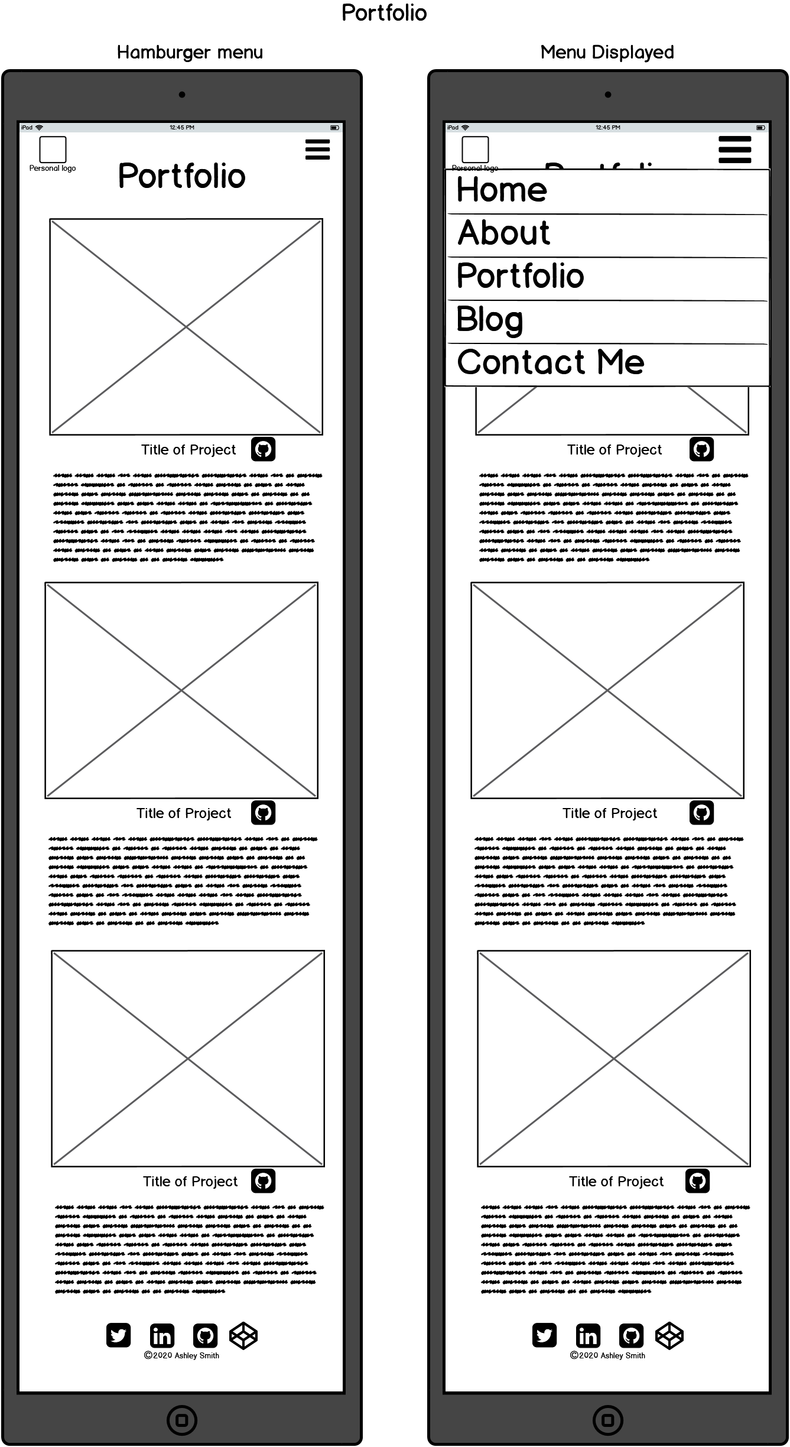
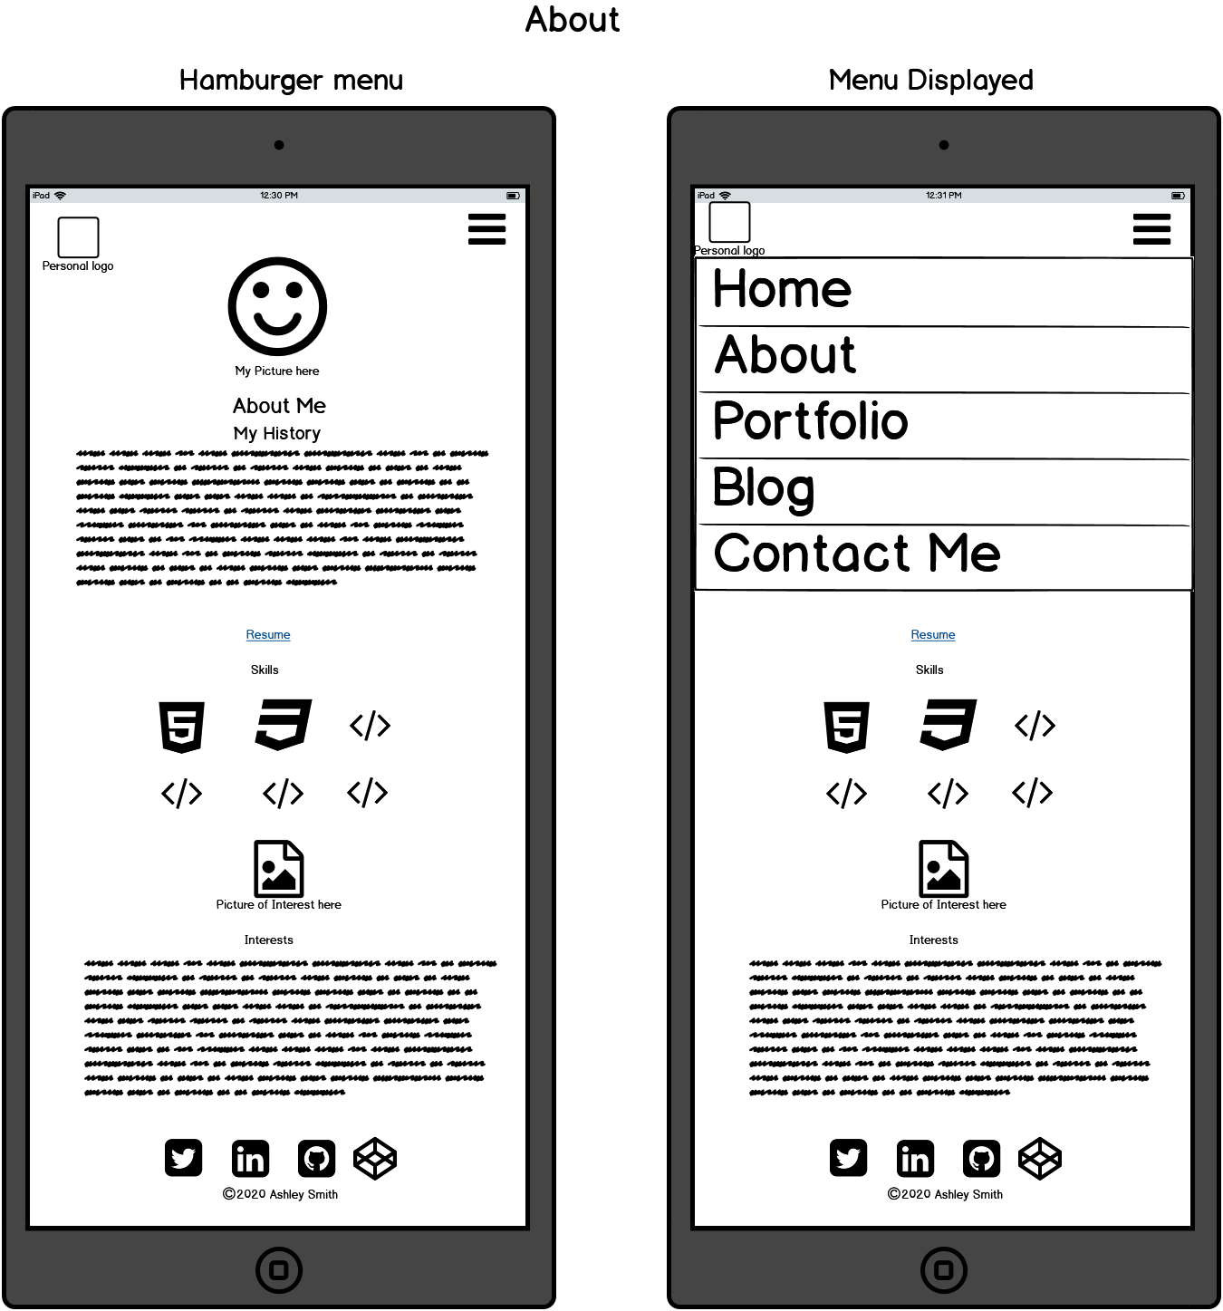
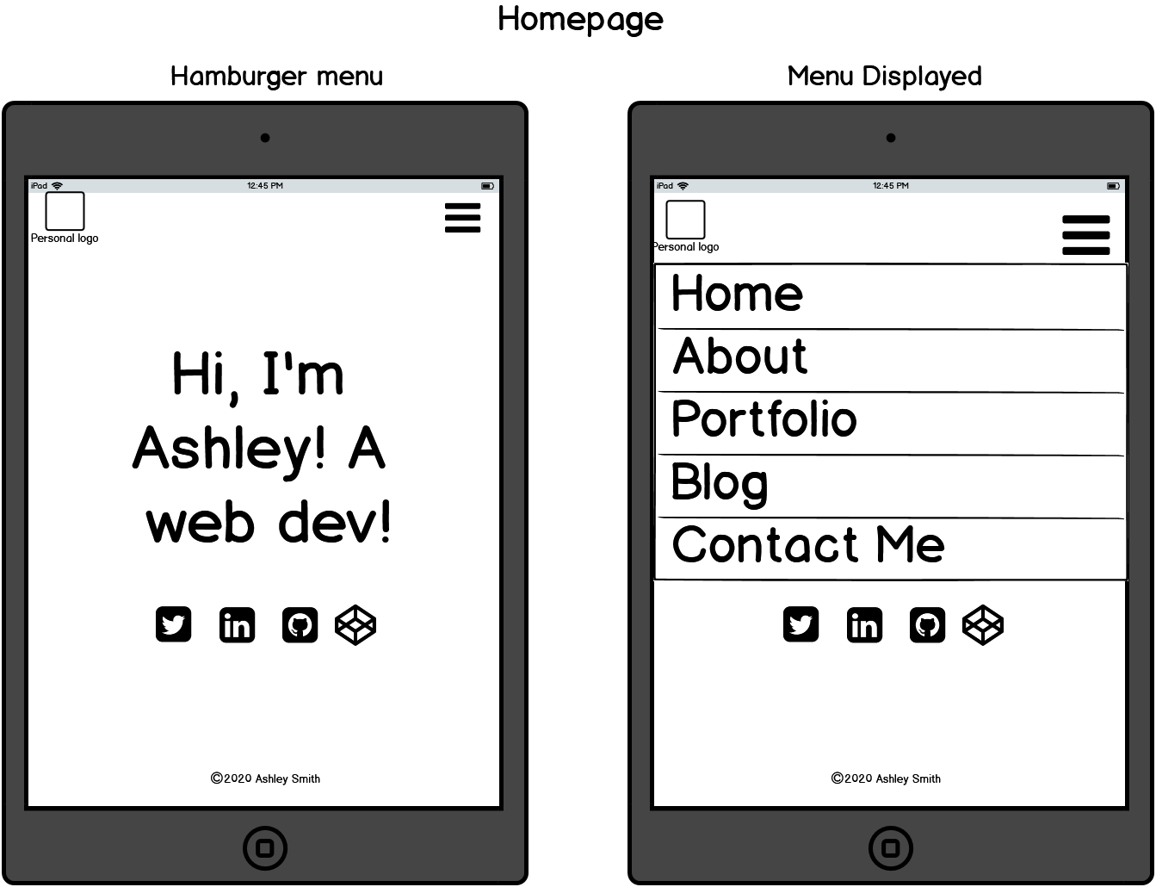
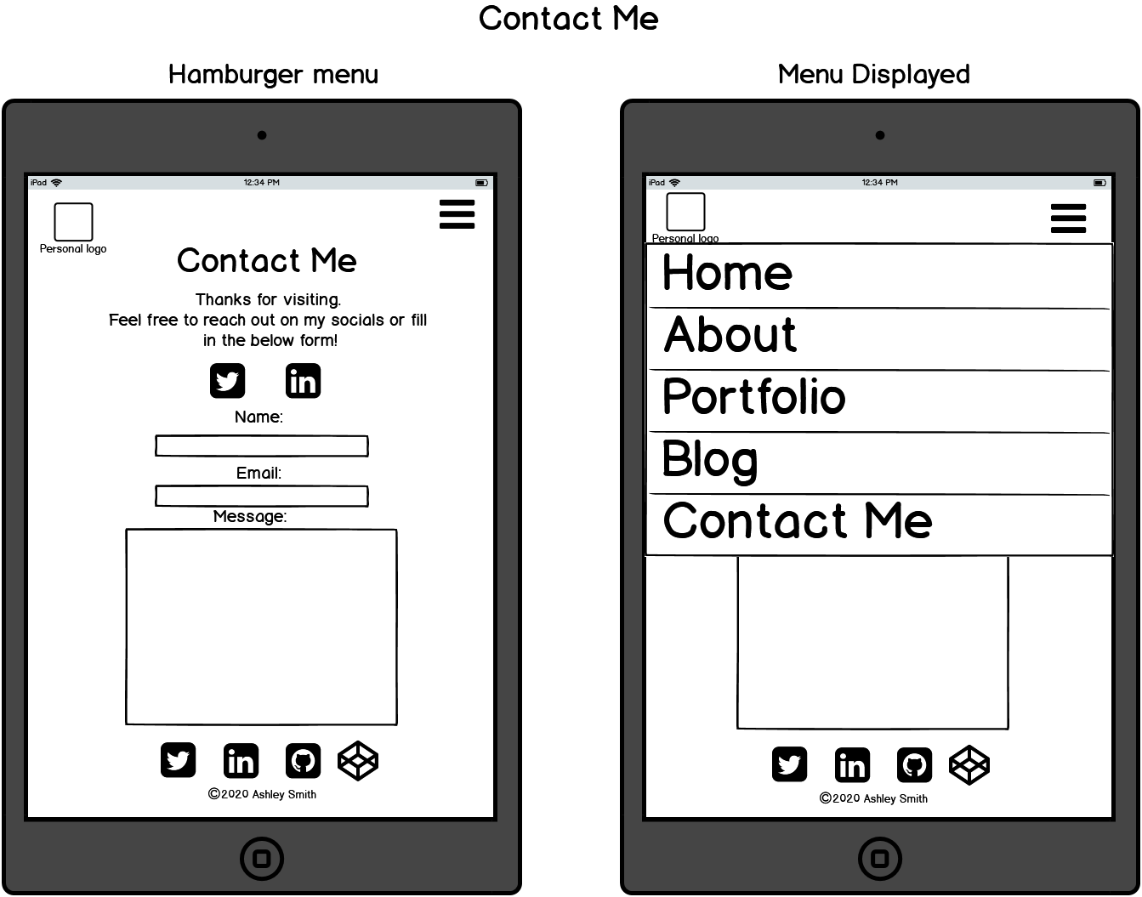
Wireframes - Tablet

Slide 9
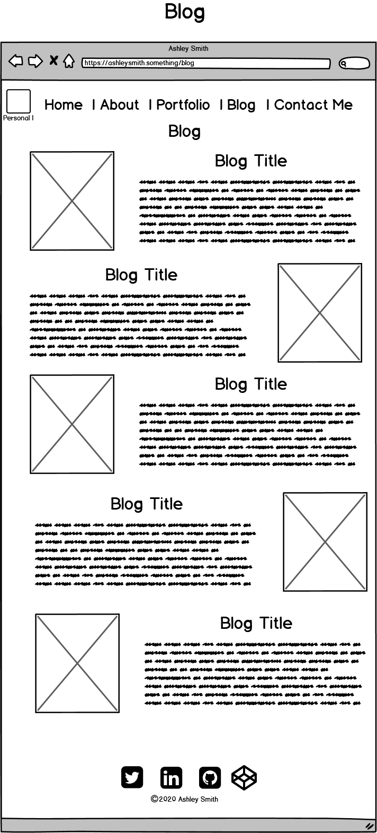
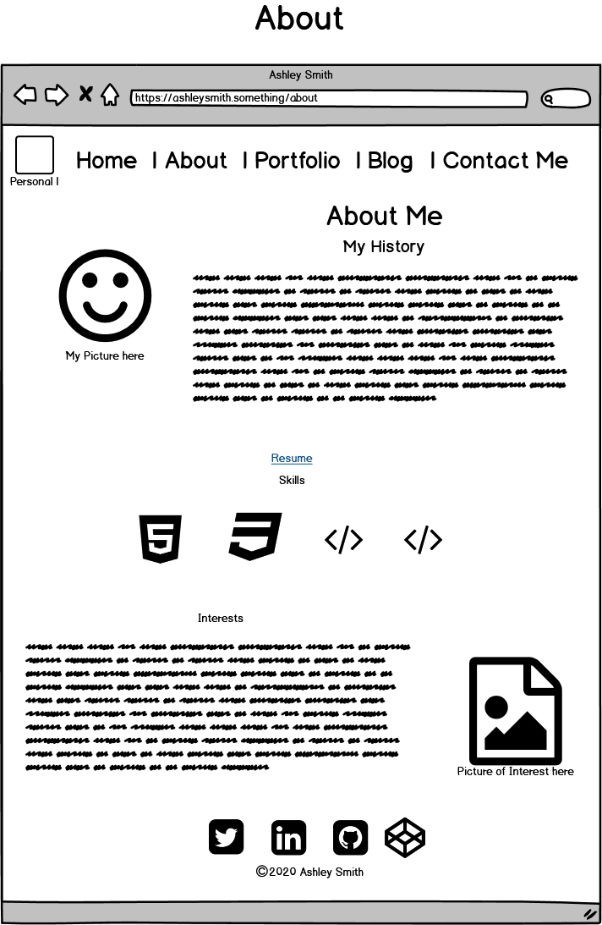
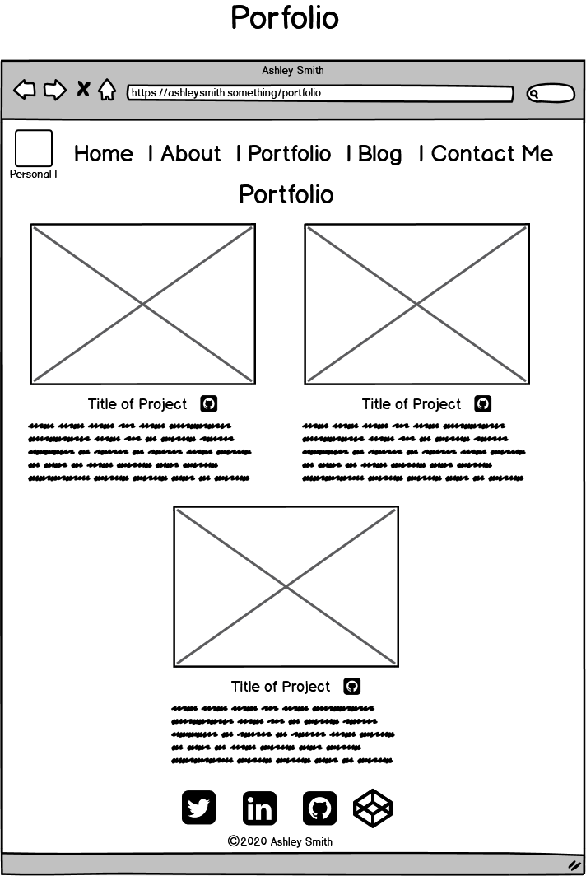
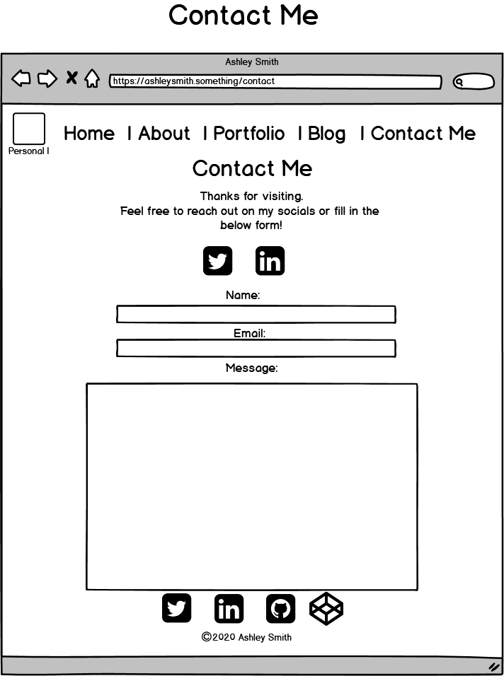
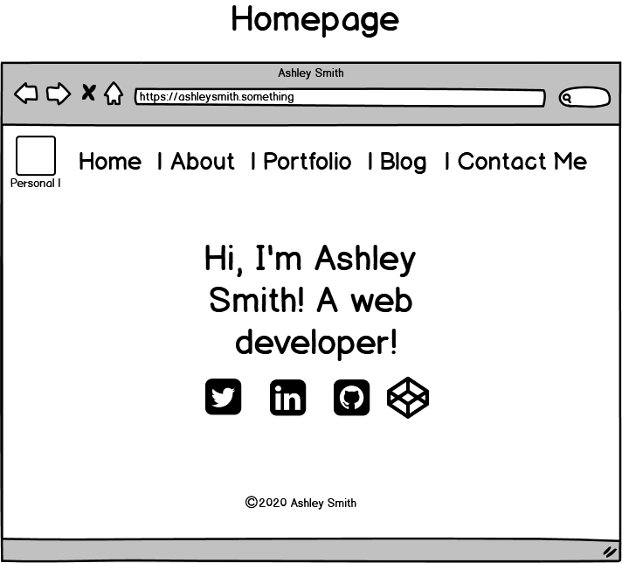
Wireframes - Desktop

Slide 10
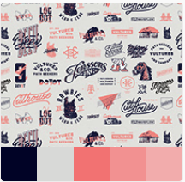
Colours and decision making
Choosing colours was difficult. I liked everything and also hated everything.
Adobe color saved my life. I searched through the trends and found something I liked.
Green, pink and blue. With a light colour for text
I found this and then played around with greens on a colour picker until I found something I liked.

Slide 11
Features aka what makes it cool and/or fun…or what makes it functional I guess…

Slide 12
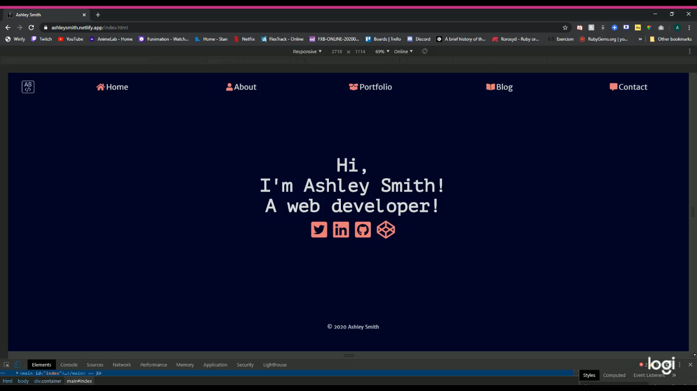
Responsive Design!
Wow! So responsive!

Slide 13
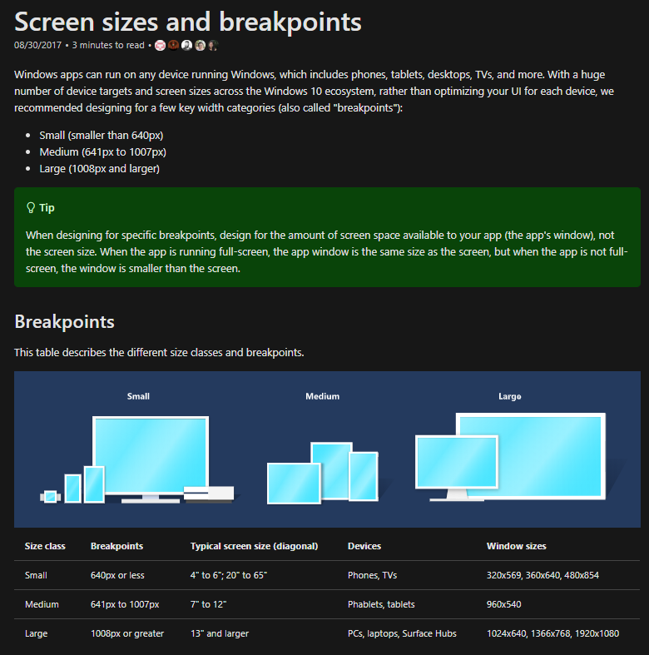
Responsive Design
Mobile first approach
Media queries for displaying on different screen sizes.
I did a lot of googling to try and determine breakpoints for my media queries and ended up following the suggested breakpoints on the right here. They seemed pretty reasonable and looked good on all the devices I tried.
Small for mobile, medium for tablet and large for desktop.

Slide 14
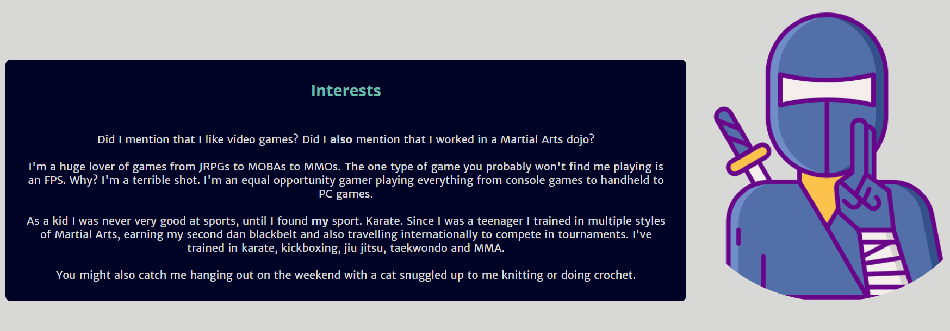
Logo
Personal
A branding image to bring the site together.
Appears on every page.
Same aesthetic as the rest of the site – simple.
My site is all about me and I wanted to showcase a bit of who I am, not just professionally but personally

Slide 15
Animations!
Because I went for a simple design I wanted to make it interactive and give it some fun features.
I have hover effects for animations, colour changes and scaling.

Slide 16
Highlights and Challenges

Slide 17
Challenges
Flexbox and grid
Hamburger menu on mobile and tablet
Finishing the workbook
Themes
On a personal level I had to deal with a side-effect of my auto-immune disorder which meant I wasn’t able to work for 3 days as my hand wasn’t responding the way it should

Slide 18
Highlights
Getting the site up and running with time to spare.
Making CSS animations.
Getting the hang (sort of) of flexbox and grid.
Being able to showcase something I’ve built and have a tangible product.
On a personal note again a big highlight for me was being able to finish everything even with the physical limitations I dealt with

Slide 19
Questions?

Slide 20
Thank you

